Slide 1


Building a Web of Things application
WoT application Manager and TD-code
Cristiano Aguzzi
@relu91
@relucri

Slide 2


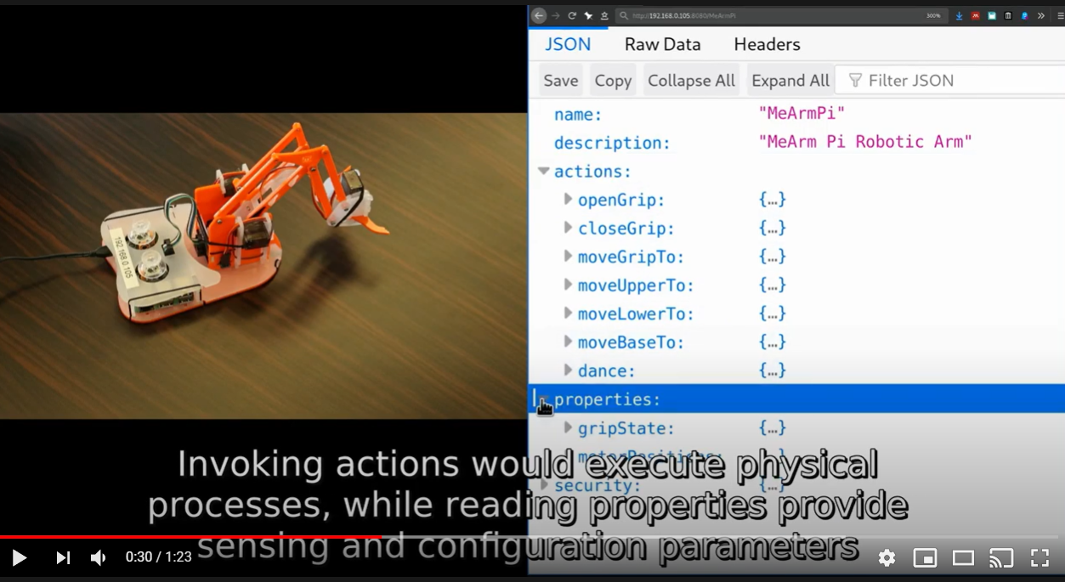

A new way to develop IoT applications
Thing Description

Slide 3


WoT Application Manager
Helps to correctly initialize a WoT application project (JS or TS)
Bundle your application in a single file
Mainly oriented to vscode projects with support for automatic code completion
Basic support for project templating
Photo made by @kensuarez on Unsplash

Slide 4

WoT Application Manager
node-wot
Photo made by @alexkixa on Unsplash

Slide 5

Demo
Photo made by @_louisreed on Unsplash

Slide 6

TD-code
Bare minimal vscode extension that adds code snippets for Thing Description files and validation.

Slide 7
Demo
Photo made by @_louisreed on Unsplash

Slide 8
Links
WAM: https://github.com/UniBO-PRISMLab/wam
Td-code: https://marketplace.visualstudio.com/items?itemName=arces-wot.td-code

Slide 9
Building a Web of Things application
WoT application Manager and TD-code

